Slide 1

Automated signature verification tools based on Machine Learning techniques can provide a scientific & objective basis for signature verification.
FORENSIC SIGNATURE VERIFICATION
•Apurva Sharma •Parth Parekh •Urjit Singh Bhatia

Slide 2
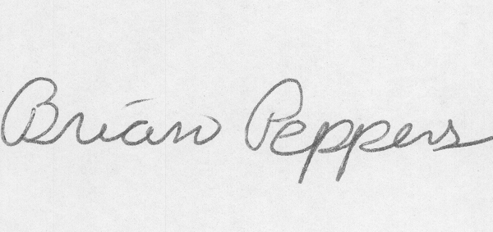
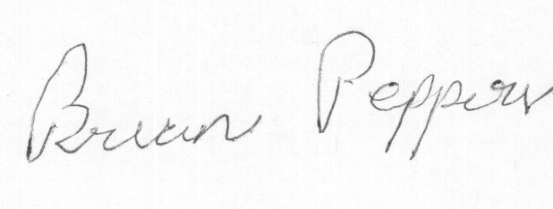
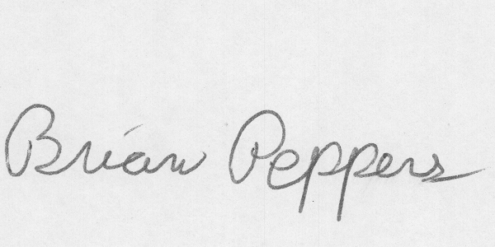
The Problem
Forgery
Genuine
Notes:
Insert a map of your country.

Slide 3

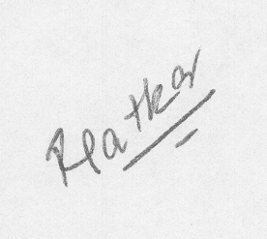

The Problem
Genuine
Forgery
Notes:
Insert a map of your country.

Slide 4
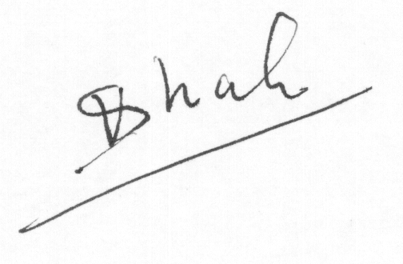
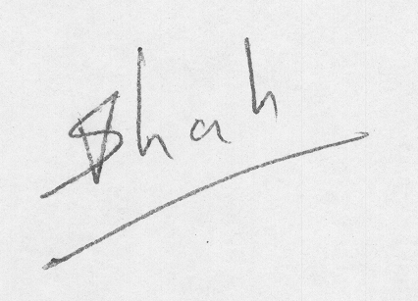
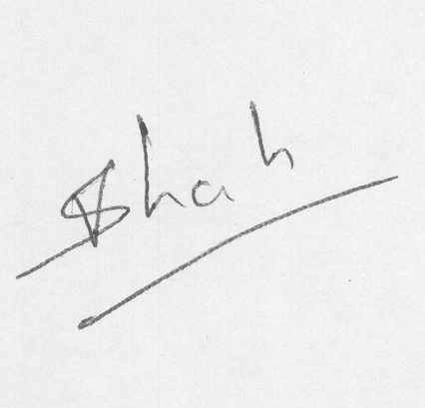
The Problem
Notes:
Insert a map of your country.

Slide 5
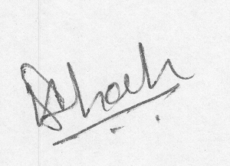
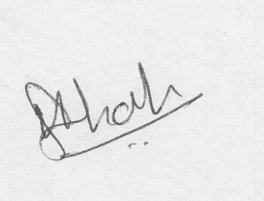
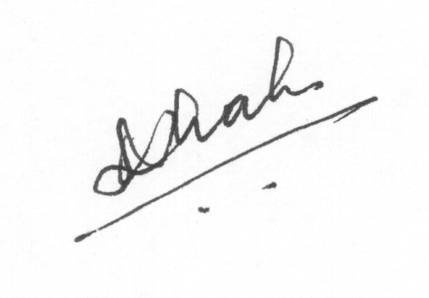
The Problem
Notes:
Insert a map of your country.

Slide 6
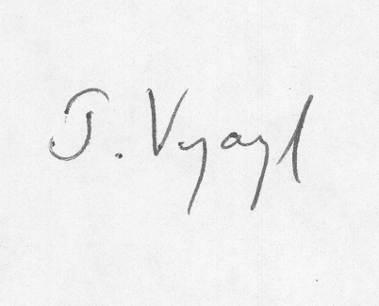
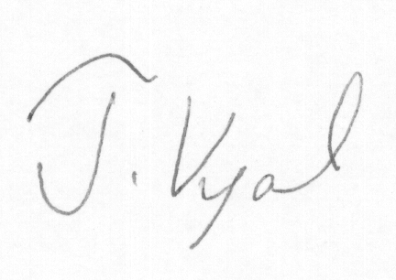
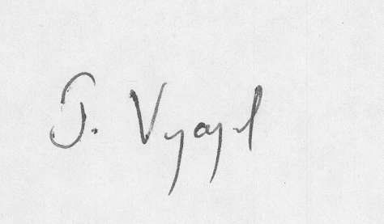
The Problem
Notes:
Insert a map of your country.

Slide 7
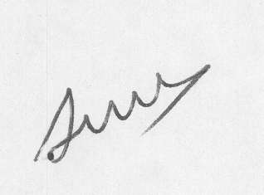
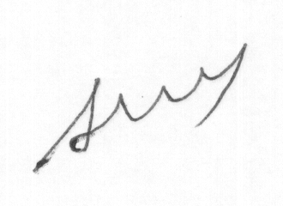

The Problem
Notes:
Insert a map of your country.

Slide 8
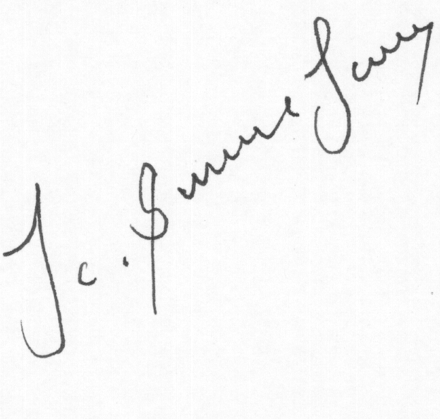
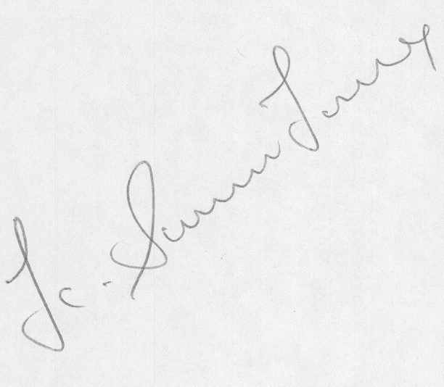
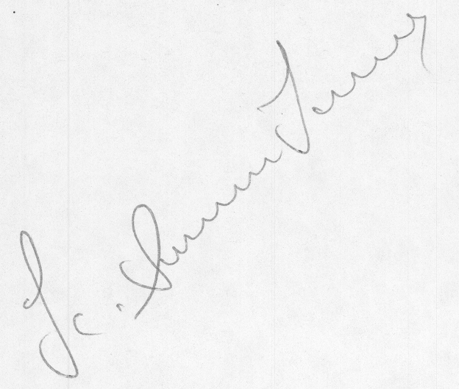
The Problem
Notes:
Insert a map of your country.

Slide 9
“Analysis of handwritten documents from the viewpoint of determining
the writer has great bearing on the criminal justice system.” Lives depend on it...

Slide 10
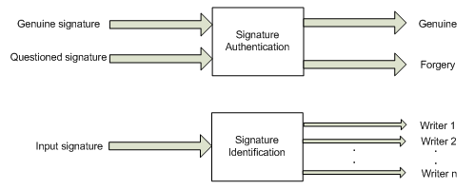
The Problem
Offline signature verification in the Forensic Signature Verification domain.
The task of identifying whether a signature is genuine or forged given a genuine copy of the signature.
Notes:
Insert a map of your country.

Slide 11
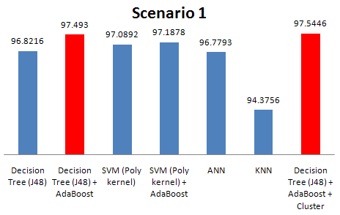
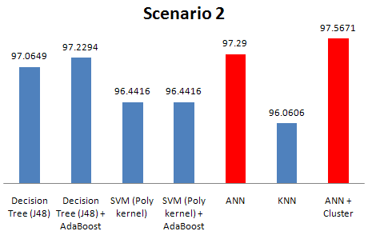
The results
Training set = 24 original, 24 forged from each of the 30 writers.
Testing set = 24 original, 24 forged for each of the remaining 25 people.
Training set = 12 original, 12 forged from each of the 55 people.
Testing set = 12 original, 12 forged of each of the 55 people.

Slide 12
Take aways…

Slide 13
The Conclusion
Extracting characteristics from the questioned and genuine signatures and computing corresponding differences provides a robust criteria for distinguishing between genuines & forgeries.
Notes:
Insert a picture of one of the geographic features of your country.

Slide 14
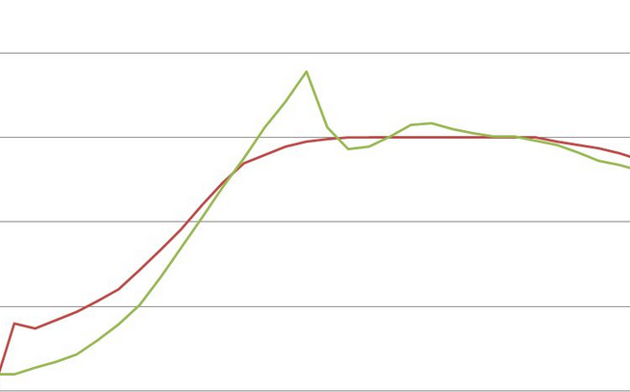
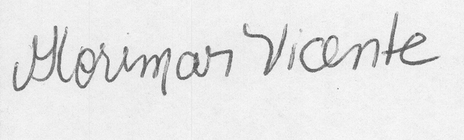
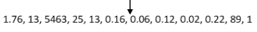
What makes this a hard problem
The ML Perspective
No Temporal Information.
Variance!!
Feature engineering.
Temporal signals – Pressure and speed
The Domain Perspective
The training of a document examiner involves years of learning.
People changes their writing styles.
External factors like pen choice, paper quality etc influence predictions.
Offline information processing
Notes:
Insert a picture illustrating a season in your country.

Slide 15
How we did it…
Walkthrough of the experiment…

Slide 16
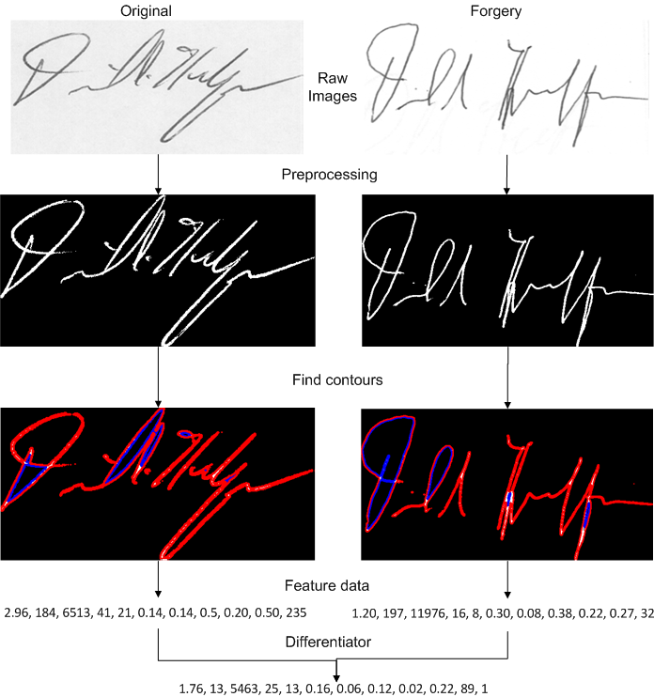
How we did it…

Slide 17
Experimental setup
Notes:
Insert a picture illustrating a season in your country.

Slide 18
Results
Notes:
Insert a picture illustrating a season in your country.

Slide 19
Review Comments Justification
Comparison
New Datasets
No ML in this
Problem with test design
Efforts for feature extraction
Explain both the datasets
Explaining chaincodes and zernike moments
Notes:
Insert a picture illustrating a season in your country.

Slide 20
Re-Conclusions
Notes:
Insert a picture illustrating a season in your country.

Slide 21
Future Work
Notes:
Insert a picture illustrating a season in your country.

